Slide 1
System Fundamentals as Facilitating
CubeSat Development
Marcus Bever
EagleSat Systems Engineer
Embry-Riddle Aeronautical University

Slide 2
Presentation Outline
The value of systems engineering
Relating the elements of design
Communication
  Model Based Systems Engineering (MBSE)
  Hierarchy diagrams
  Functional flow block diagrams
Tailoring
Conclusion

Slide 3
Why Make the Effort
Requirement verification
  Meet the goal
Design traceability
  Answer the question of “Why?”
Design update compatibility
  Manage flow down of modifications
System level documentation
  Communicate the big picture without missing the details
Notes:
The investment of system level coordination
Big picture is important → [top down design]

Slide 4
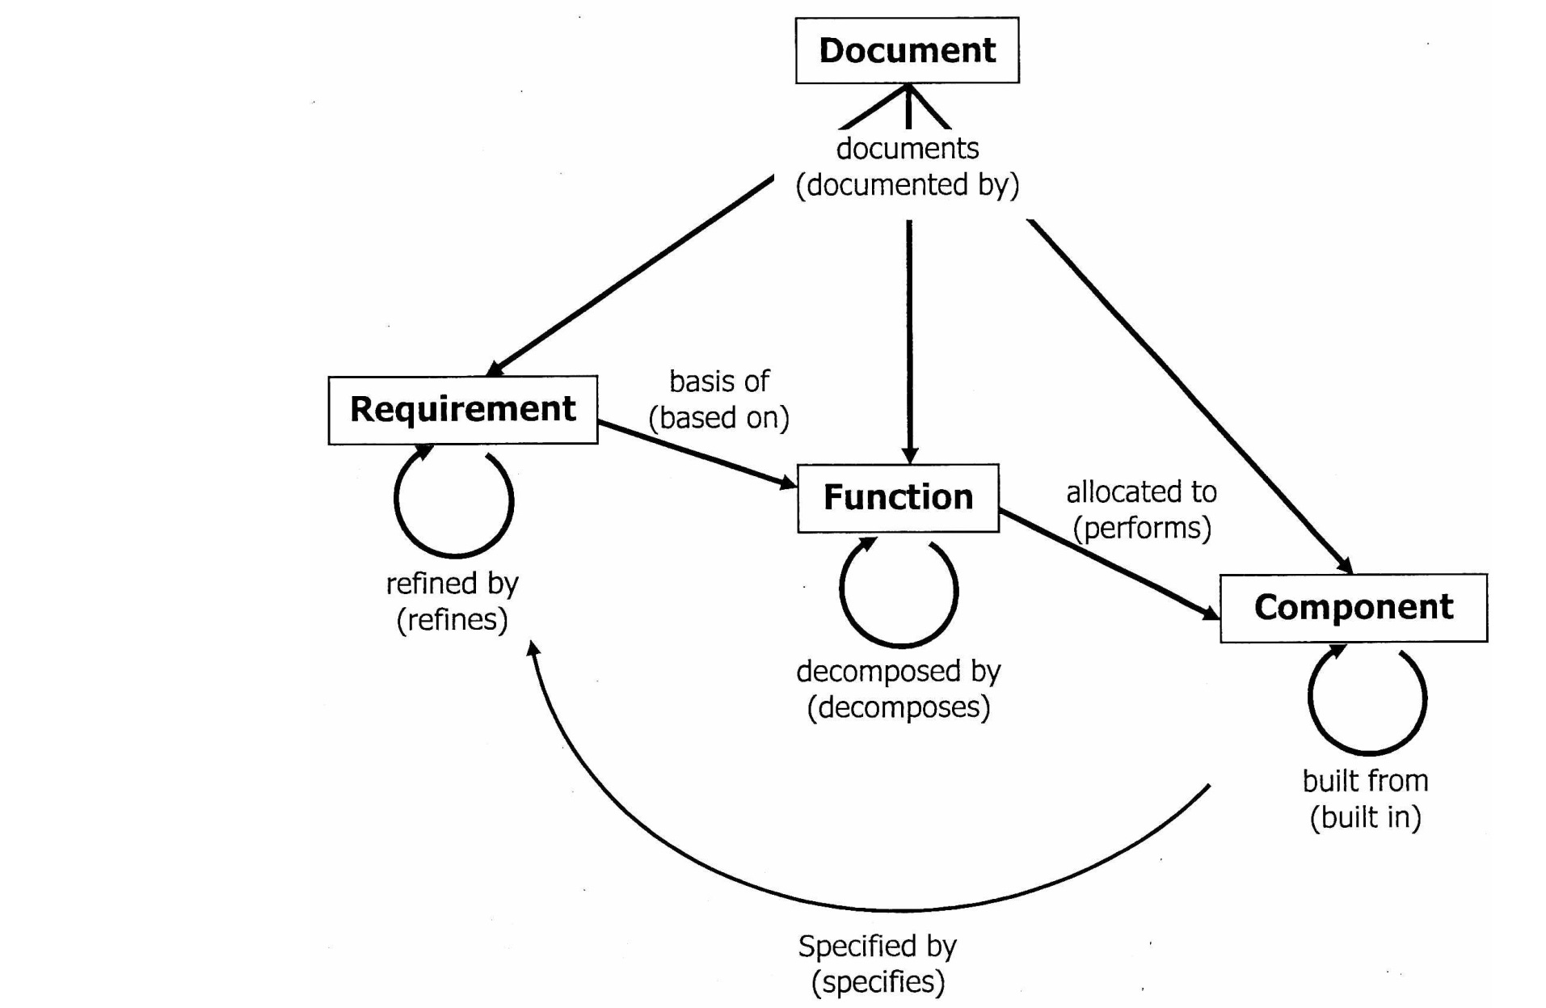
What’s the Focus?
Top down design
Design triangle
  Requirements: what is being done
  Functions: how is it being accomplished
  Hardware: what is accomplishing it
Iterative and recursive application
Notes:
Decompose
Function begets form
Hardware is the realization of anticipated functions
Elements of traceability repeatedly emphasized

Slide 5

Communication
Words
Words
Words
Words
Words
Words
Words
Words
Words
Words
Words
Words
Words
Words
Words
Words
Words
Words
Words
Words
Words
Words
Words
Words
Words
Words
Words
Words
Words
Words
Words
Words
Words
Words
Words
Words
Words
Words
Words
Words
Words
Words
Words
Words
Words
Words
Words
Words
Words
Words
Words
Words
Words
Words
Words
Words
Words
Words
Words
Words
Words
Words
Words
Words
Words
Words
Words
Words
Words
Words
Words
Words
Words
Words
Words
Words
Words
Words
Words
Words
Words
Words
Words
Words
Words
Words
Words
Words
Words
Words
Words
Words
Words
Words
Words
Words
Words
Words
Words
Words
Words
Words
Words
Words
Words
Words
Words
Words
Words
Words
Words
Words
Words
Words
Words
Words
Words
Words
Words
Words
Words
Words
Words
Words
Words
Words
Words
Words
Words
Words
Words
Words
Words
Words
Words
Words
Notes:
Picture is worth 1000 words
scalable picture?!

Slide 6



Model Based Systems Engineering
Communication through diagrams
  Represents traceability graphically
  Clearly shows interrelationships
  Maintains organization through numbering
Includes clarifying descriptions
Satellite = Sat + Light
Notes:
Appropriately applied to our project – current focus on basic diagrams and design representation (allows for later development)
Greatest challenges is effective communication
Elements of primary traceability
Systematic numbering
Clarifying descriptions – no interpretive dance

Slide 7
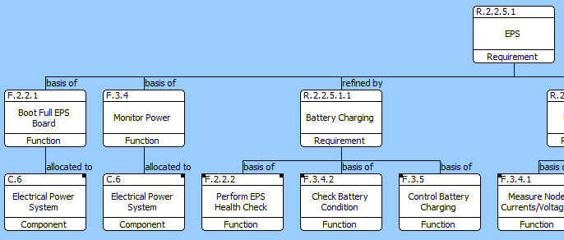
Hierarchies: Tool of Systems Thinking
Clear representation of requirement, function, and hardware breakdown
Numbering
Classification
Title
Relationship
Notes:
One of the primary tools
Descriptions not shows here – presented elsewhere
Applies to each of the three classes
functions also have…

Slide 8
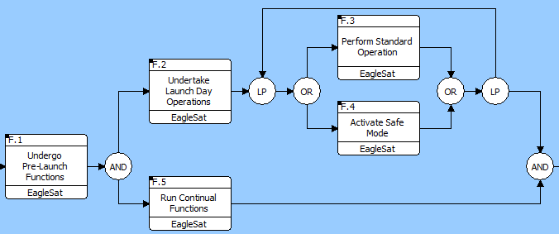
Functional Flow Block Diagrams
Functional model of operations, sequencing, and conditions
Numbering
Project
Title
Operational Flow

Slide 9
Tailoring
Not every document is suited for every project
Tools vary with resources and program
  Website development
  Tailored documentation
  Meetings
Support team in satellite development
  Various tools → selection of most appropriate
Notes:
Presentation through hierarchies not good
Configuration management of website

Slide 10
Conclusion
Communicate
  MBSE: hierarchies, functional flow black diagrams
  Choosing the right tool
Coordinate
  Traceability and documentation
  Don’t miss the details!
Collaborate
  Support the technical progress of the satellite
Notes:
Communication is imperative

Slide 11
Questions
Marcus Bever
Embry-Riddle EagleSat
beverm@my.erau.edu

